Slide 1
Disaster Tweets Classification
CS304N course project
- Lohith Reddy Ramireddy 200001066

Slide 2


Table of contents:
Introduction
Problem statement
Data set collection
Data pre-processing
Approach
Further scope and learning

Slide 3

Introduction:
Third bullet point here
The way of communication has changed a lot these days from newspapers, radios to smartphones.
Here in this social world emerged “Twitter”.
Twitter is being used to spread news, updates, personal opinions etc, and being used widely by many organisations and big companies etc.

Slide 4
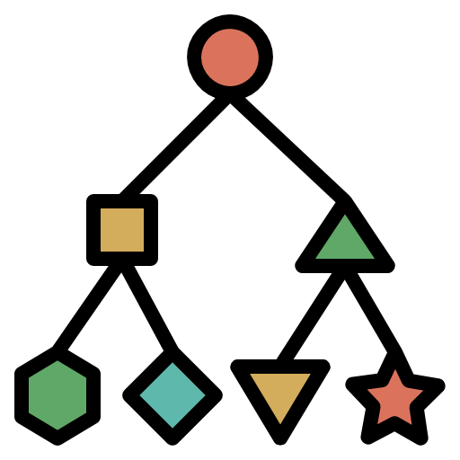
Twitter has proven its effectiveness in the times of disasters like fire accidents, floods, earthquakes, wildfires etc.
There are an estimated 500million users on twitter worldwide.
But not all tweets are informative in nature.
Here comes the need of classification of tweets regarding various disasters.

Slide 5
Problem statement:
Twitter is an emergency communication channel in times of emergency.
Since use of smartphones has increased drastically these days, which enables people to announce emergency immediately
Because of this more agencies are interested to programmatically monitoring twitter.
A tweet might be clear to human that they are in emergency, but may not be clear for a machine.
So we build a machine learning model that predicts which tweets are real about disasters and which are not.
Its basically a binary classification model into REAL or NOT.

Slide 6

Data set collection:
In this study, I’ve used the social media disaster tweets data set provided by Kaggle.
Its freely available to view and download on Kaggle.com.
In this dataset, they’ve provided more than 10,000 tweets.
We estimate whether a tweet is regarding disaster or not from these 10,000 tweets.

Slide 7
Each entry in the data set includes the following details:
Id – tweet No.
Text – text of the tweet.
Location – location from which tweet is delivered.
Keyword – a keyword like bushfire, forest fire, cyclone etc.
Target – whether the tweet is REAL disaster or NOT.

Slide 8

Data pre-processing:
Data pre processing has different parts in it which includes:
Data Cleaning
Changing text to all lower or all upper
Removing noise
Tokenization
Stop word removal
Stemming
Lemmatization

Slide 9


Slide 10
Approach:
Here I’ll be using some already developed models to classify the tweets into REAL disasters or NOT.
Here I’ll be implementing 3 classification models and use the model which gives me more accurate predictions.
Logistic Regression model
Decision tree classifier model
Random forest classifier model

Slide 11
Model performance metrics:
Here ill be using these 3 performance metrics:
Confusion matrix
F1 score
Accuracy

Slide 12
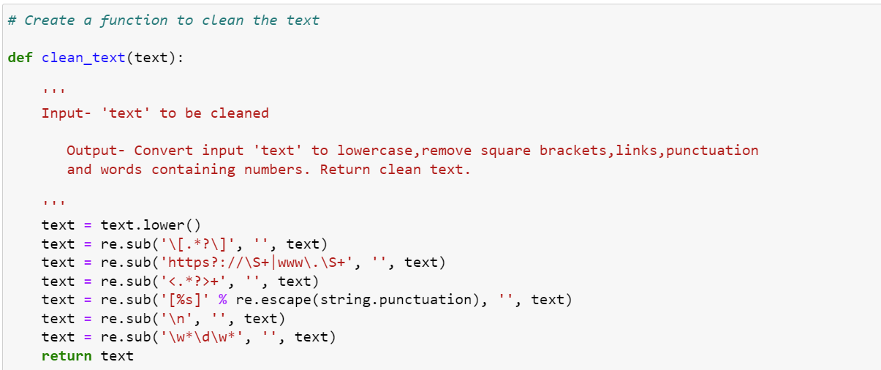
Data Cleaning

Slide 13
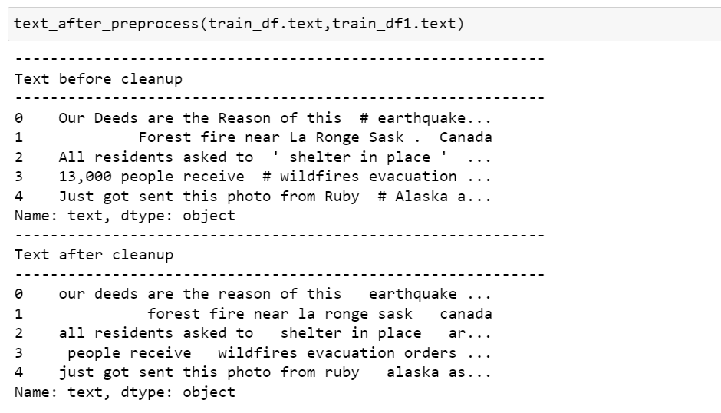
Data cleaning Contd…

Slide 14
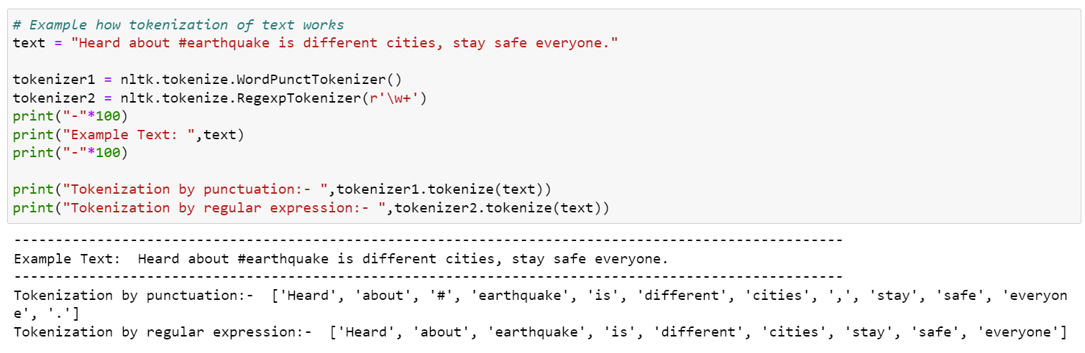
Tokenization

Slide 15
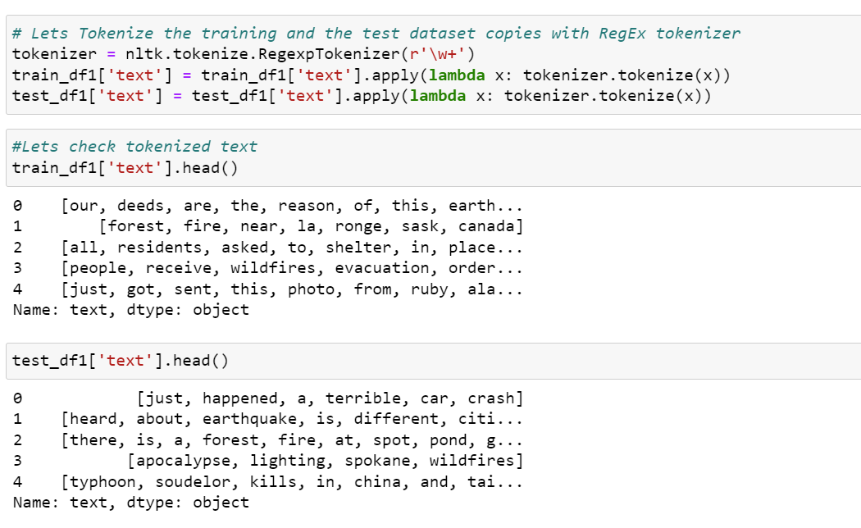
Tokenization contd…

Slide 16
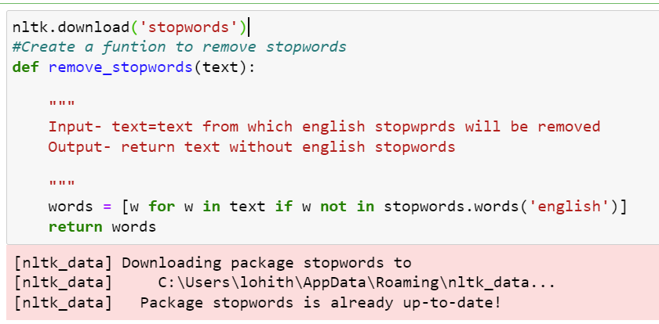
Stop words removal

Slide 17
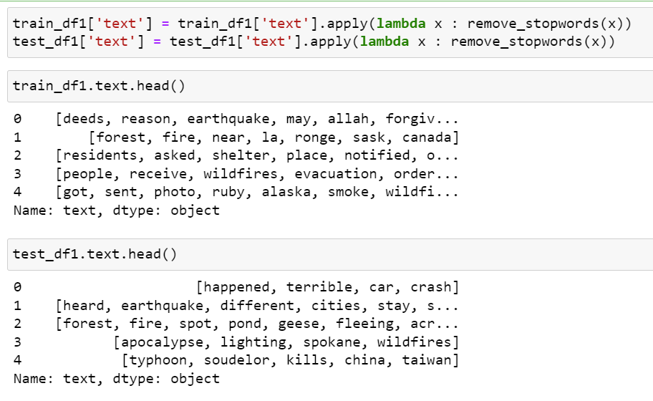
Stop words removal contd…

Slide 18
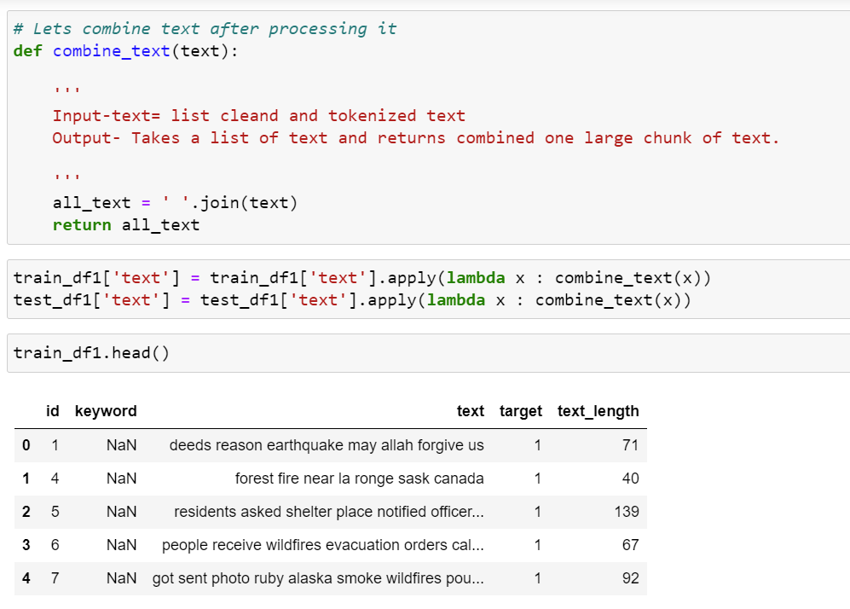
Combining all the tokens

Slide 19
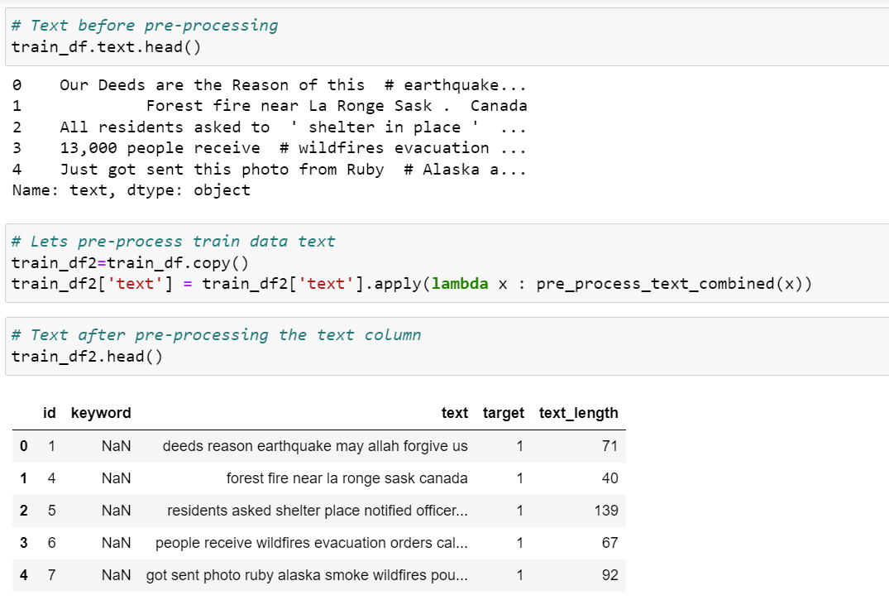
Before vs After Data Pre-Processing

Slide 20
Vectorization of text
There are mainly 2 types of vectorization we use:
Count vectorization
Tf-idf vectorization

Slide 21
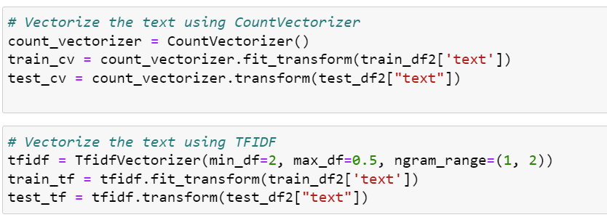
Count & TF-IDF vectorization

Slide 22
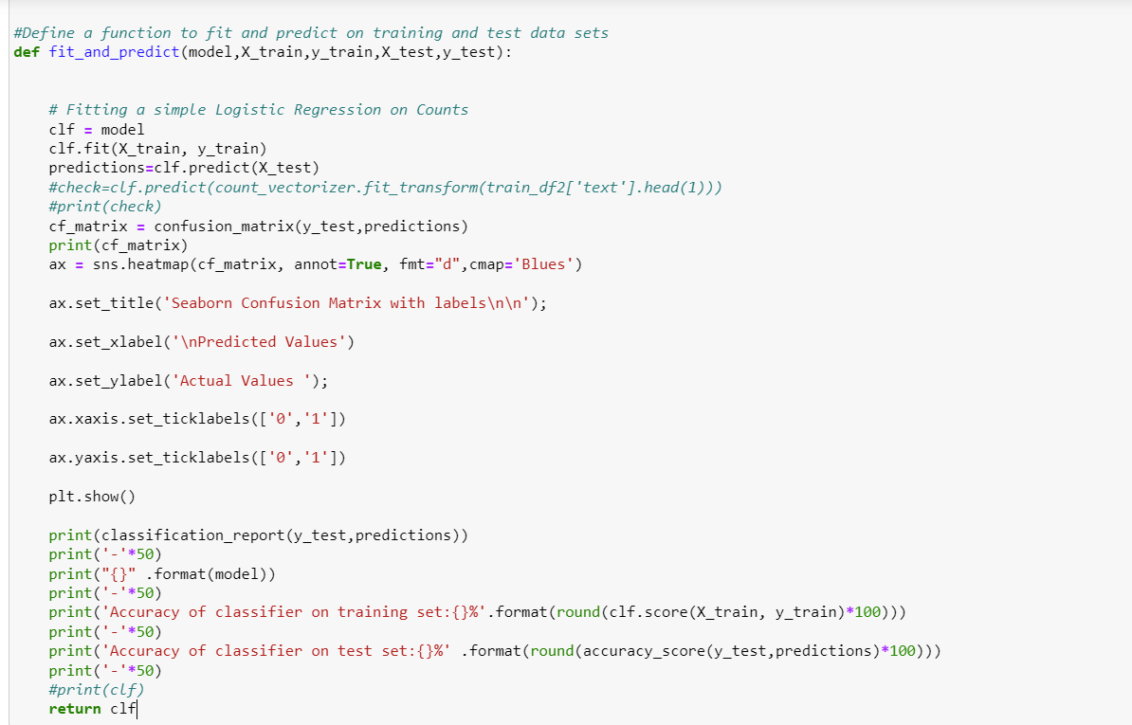
Fit and Predict

Slide 23
Confusion matrices of various models using Count vectorization

Slide 24
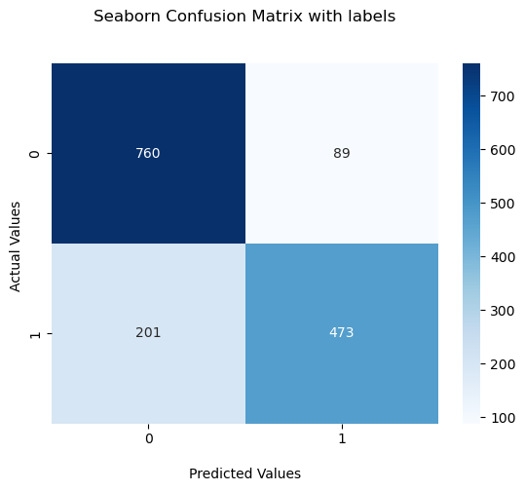
Confusion matrix- Logistic Regression

Slide 25
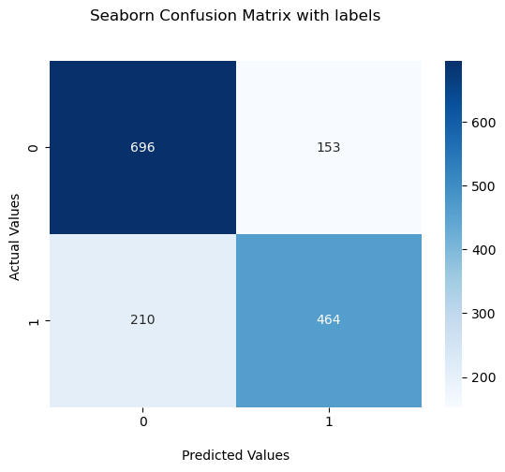
Confusion matrix- DecisionTreeClassifier

Slide 26

Confusion matrix- RandomForestClassifier

Slide 27
Confusion matrices of various models using TF-IDF vectorization

Slide 28

Confusion matrix- Logistic Regression

Slide 29
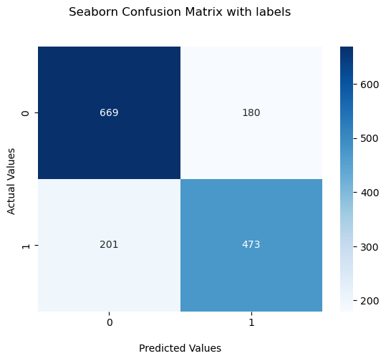
Confusion matrix- DecisionTreeClassifier

Slide 30

Confusion matrix- RandomForestClassifier

Slide 31
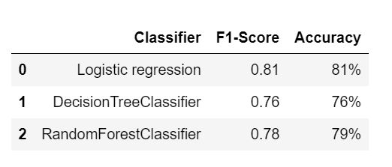
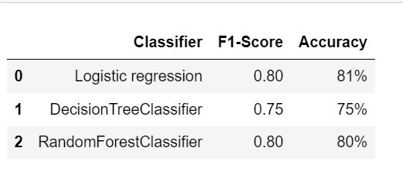
Count TF-IDF
Count vs TF-IDF vectorization

Slide 32
Further scope for improvement:
There is more further scope to continue this machine learning model and extend it to classifying audios, videos, images etc.
After that we may even classify images, videos, audios into which they are of explicit content or not.

Slide 33
Thank you

